Slide 1
Sorting

Slide 2
Why Sorting?
Practical application
People by last name
Countries by population
Search engine results by relevance
Fundamental to other algorithms
Different algorithms have different asymptotic and constant-factor trade-offs
No single ‘best’ sort for all scenarios
Knowing one way to sort just isn’t enough
Many to approaches to sorting which can be used for other problems

Slide 3
Problem statement
There are n comparable elements in an array and we want to rearrange them to be in increasing order
Pre:
An array A of data records
A value in each data record
A comparison function
<, =, >, compareTo
Post:
For each distinct position i and j of A, if i<j then A[i] ≤ A[j]
A has all the same data it started with and in specified order

Slide 4
Sorting Classification
In memory sorting |  |  | External sorting
Comparison sorting Ω(N log N) |  | Specialized Sorting
O(N²) | O(N log N) | O(N)
Bubble Sort Selection Sort Insertion Sort Shell Sort | Merge Sort Quick Sort Heap Sort | Bucket Sort Radix Sort | Simple External Merge Sort Variations

Slide 5
Comparison Sorting
Determine order through comparisons on the input data

Slide 6
Bubble Sorting

Slide 7
Bubble sort
bubble sort: orders a list of values by repetitively comparing neighboring elements and swapping their positions if necessary
more specifically:
scan the list, exchanging adjacent elements if they are not in relative order; this bubbles the highest value to the top
scan the list again, bubbling up the second highest value
repeat until all elements have been placed in their proper order

Slide 8
"Bubbling" largest element
Traverse a collection of elements
Move from the front to the end
"Bubble" the largest value to the end using pair-wise comparisons and swapping
Swap
0 1 2 3 4 5
42
77
77
42
35
12
101
5

Slide 9
"Bubbling" largest element
Traverse a collection of elements
Move from the front to the end
"Bubble" the largest value to the end using pair-wise comparisons and swapping
0 1 2 3 4 5
Swap
35
77
42
77
35
12
101
5

Slide 10
"Bubbling" largest element
Traverse a collection of elements
Move from the front to the end
"Bubble" the largest value to the end using pair-wise comparisons and swapping
0 1 2 3 4 5
Swap
12
77
42
35
77
12
101
5

Slide 11
"Bubbling" largest element
Traverse a collection of elements
Move from the front to the end
"Bubble" the largest value to the end using pair-wise comparisons and swapping
0 1 2 3 4 5
42
35
12
77
101
5
No need to swap

Slide 12
"Bubbling" largest element
Traverse a collection of elements
Move from the front to the end
"Bubble" the largest value to the end using pair-wise comparisons and swapping
0 1 2 3 4 5
Swap
5
101
42
35
12
77
101
5

Slide 13
"Bubbling" largest element
Traverse a collection of elements
Move from the front to the end
"Bubble" the largest value to the end using pair-wise comparisons and swapping
0 1 2 3 4 5
101
42
35
12
77
5
Largest value correctly placed

Slide 14
Bubble sort code
public static void bubbleSort(int[] a) {
for (int i = 0; i < a.length ; i++) {
for (int j = 1; j < a.length - i; j++) {
// swap adjacent out-of-order elements
if (a[j-1] > a[j]) {
swap(a, j-1, j);
}
}
}
}

Slide 15
Selection Sort

Slide 16
Selection sort
selection sort: orders a list of values by repetitively putting a particular value into its final position
more specifically:
find the smallest value in the list
switch it with the value in the first position
find the next smallest value in the list
switch it with the value in the second position
repeat until all values are in their proper places

Slide 17
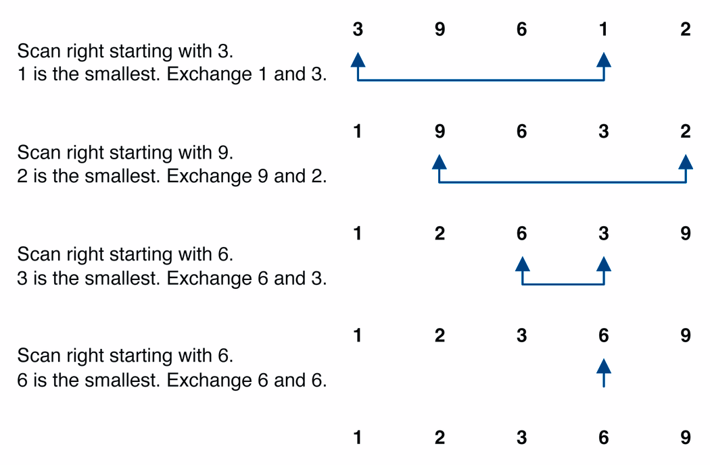
Selection sort example

Slide 18
Selection sort example 2
Index | 0 | 1 | 2 | 3 | 4 | 5 | 6 | 7
Value | 27 | 63 | 1 | 72 | 64 | 58 | 14 | 9
1st pass | 1 | 63 | 27 | 72 | 64 | 58 | 14 | 9
2nd pass | 1 | 9 | 27 | 72 | 64 | 58 | 14 | 63
3rd pass | 1 | 9 | 14 | 72 | 64 | 58 | 27 | 63
…
Notes:
The selection sort marks the first element (27). It then goes through the remaining
data to find the smallest number(1). It swaps this with the first element and the smallest element is now in its correct position. It then marks the second element (63) and looks through the remaining data for the next smallest number (9). These two numbers are then swapped. This process continues until n-1 passes have been made.

Slide 19
Selection sort code
public static void selectionSort(int[] a) {
for (int i = 0; i < a.length; i++) {
// find index of smallest element
int minIndex = i;
for (int j = i + 1; j < a.length; j++) {
if (a[j] < a[minIndex]) {
minIndex = j;
}
}
// swap smallest element with a[i]
swap(a, i, minIndex);
}
}

Slide 20
Insertion Sort

Slide 21
Insertion sort
insertion sort: orders a list of values by repetitively inserting a particular value into a sorted subset of the list
more specifically:
consider the first item to be a sorted sublist of length 1
insert the second item into the sorted sublist, shifting the first item if needed
insert the third item into the sorted sublist, shifting the other items as needed
repeat until all values have been inserted into their proper positions

Slide 22
Insertion sort
Simple sorting algorithm.
n-1 passes over the array
At the end of pass i, the elements that occupied A[0]…A[i] originally are still in those spots and in sorted order.
2 | 15 | 8 | 1 | 17 | 10 | 12 | 5
0 | 1 | 2 | 3 | 4 | 5 | 6 | 7
after
pass 2
2 | 8 | 15 | 1 | 17 | 10 | 12 | 5
0 | 1 | 2 | 3 | 4 | 5 | 6 | 7
after
pass 3
1 | 2 | 8 | 15 | 17 | 10 | 12 | 5
0 | 1 | 2 | 3 | 4 | 5 | 6 | 7

Slide 23
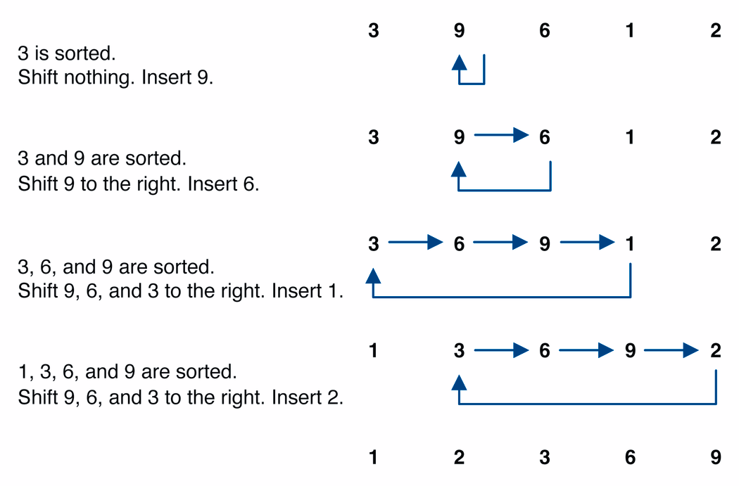
Insertion sort example

Slide 24
Insertion sort code
public static void insertionSort(int[] a) {
for (int i = 1; i < a.length; i++) {
int temp = a[i];
// slide elements down to make room for a[i]
int j = i;
while (j > 0 && a[j - 1] > temp) {
a[j] = a[j - 1];
j--;
}
a[j] = temp;
}
}

Slide 25
MergeSort

Slide 26
MergeSort
MergeSort is a divide and conquer method of sorting
26

Slide 27
MergeSort Algorithm
MergeSort is a recursive sorting procedure that uses at most O(n lg(n)) comparisons.
To sort an array of n elements, we perform the following steps in sequence:
If n < 2 then the array is already sorted.
Otherwise, n > 1, and we perform the following three steps in sequence:
Sort the left half of the the array using MergeSort.
Sort the right half of the the array using MergeSort.
Merge the sorted left and right halves.
27

Slide 28
How to Merge
Here are two lists to be merged:
First: (12, 16, 17, 20, 21, 27)
Second: (9, 10, 11, 12, 19)
Compare12 and 9
First: (12, 16, 17, 20, 21, 27)
Second: (10, 11, 12, 19)
New: (9)
Compare 12 and 10
First: (12, 16, 17, 20, 21, 27)
Second: (11, 12, 19)
New: (9, 10)
28

Slide 29
Merge Example
Compare 12 and 11
First: (12, 16, 17, 20, 21, 27)
Second: (12, 19)
New: (9, 10, 11)
Compare 12 and 12
First: (16, 17, 20, 21, 27)
Second: (12, 19)
New: (9, 10, 11, 12)
29

Slide 30
Merge Example
Compare 16 and 12
First: (16, 17, 20, 21, 27)
Second: (19)
New: (9, 10, 11, 12, 12)
Compare 16 and 19
First: (17, 20, 21, 27)
Second: (19)
New: (9, 10, 11, 12, 12, 16)
30

Slide 31
Merge Example
Compare 17 and 19
First: (20, 21, 27)
Second: (19)
New: (9, 10, 11, 12, 12, 16, 17)
Compare 20 and 19
First: (20, 21, 27)
Second: ( )
New: (9, 10, 11, 12, 12, 16, 17, 19)
31
Notes:
31

Slide 32
Merge Example
Checkout 20 and empty list
First: ( )
Second: ( )
New: (9, 10, 11, 12, 12, 16, 17, 19, 20, 21, 27)
32
Notes:
32

Slide 33
MergeSort
33
Notes:
33

Slide 34
Merge-Sort Tree
An execution of merge-sort is depicted by a binary tree
each node represents a recursive call of merge-sort and stores
unsorted sequence before the execution and its partition
sorted sequence at the end of the execution
the root is the initial call
the leaves are calls on subsequences of size 0 or 1
7 2 ⏐ 9 4 → 2 4 7 9
7 ⏐ 2 → 2 7
9 ⏐ 4 → 4 9
7 → 7
2 → 2
9 → 9
4 → 4
34
Notes:
34

Slide 35
Execution Example
Partition
7 2 9 4 ⏐ 3 8 6 1
35
Notes:
35

Slide 36
Execution Example (cont.)
Recursive call, partition
7 2 9 4 ⏐ 3 8 6 1
7 2 ⏐ 9 4
36
Notes:
36

Slide 37
Execution Example (cont.)
Recursive call, partition
7 2 9 4 ⏐ 3 8 6 1
7 2 ⏐ 9 4
7 ⏐ 2
37

Slide 38
Execution Example (cont.)
Recursive call, base case
7 2 9 4 ⏐ 3 8 6 1
7 2 ⏐ 9 4
7 ⏐ 2
7 → 7
38

Slide 39
Execution Example (cont.)
Recursive call, base case
7 2 9 4 ⏐ 3 8 6 1
7 2 ⏐ 9 4
7 ⏐ 2
7 → 7
2 → 2
39

Slide 40
Execution Example (cont.)
Merge
7 2 9 4 ⏐ 3 8 6 1
7 2 ⏐ 9 4
7 ⏐ 2 → 2 7
7 → 7
2 → 2
40

Slide 41
Execution Example (cont.)
Recursive call, …, base case, merge
7 2 9 4 ⏐ 3 8 6 1
7 2 ⏐ 9 4
7 ⏐ 2 → 2 7
9 4 → 4 9
7 → 7
2 → 2
9 → 9
4 → 4
41

Slide 42
Execution Example (cont.)
Merge
7 2 9 4 ⏐ 3 8 6 1
7 2 ⏐ 9 4 → 2 4 7 9
7 ⏐ 2 → 2 7
9 4 → 4 9
7 → 7
2 → 2
9 → 9
4 → 4
42

Slide 43
Execution Example (cont.)
Recursive call, …, merge, merge
7 2 9 4 ⏐ 3 8 6 1
7 2 ⏐ 9 4 → 2 4 7 9
3 8 6 1 → 1 3 6 8
7 ⏐ 2 → 2 7
9 4 → 4 9
3 8 → 3 8
6 1 → 1 6
7 → 7
2 → 2
9 → 9
4 → 4
3 → 3
8 → 8
6 → 6
1 → 1
43

Slide 44
Execution Example (cont.)
Merge
7 2 9 4 ⏐ 3 8 6 1 → 1 2 3 4 6 7 8 9
7 2 ⏐ 9 4 → 2 4 7 9
3 8 6 1 → 1 3 6 8
7 ⏐ 2 → 2 7
9 4 → 4 9
3 8 → 3 8
6 1 → 1 6
7 → 7
2 → 2
9 → 9
4 → 4
3 → 3
8 → 8
6 → 6
1 → 1
44

Slide 45
// A : Array that needs to be sorted
MergeSort(A)
{
n = length(A)
if n<2 return
mid = n/2
left = new_array_of_size(mid) // Creating temporary array for left
right = new_array_of_size(n-mid) // and right sub arrays
for(int i=0 ; i<=mid-1 ; ++i)
{
left[i] = A[i] // Copying elements from A to left
}
for(int i=mid ; i<=n-1 ; ++i)
{
right[i-mid] = A[i] // Copying elements from A to right
}
MergeSort(left) // Recursively solving for left sub array
MergeSort(right) // Recursively solving for right sub array
merge(left, right, A) // Merging two sorted left/right sub array to final array
}

Slide 46
Bitonic Sort
Bitonic Sort is a classic parallel algorithm for sorting.
It is an Comparison based sorting algorithm.
The number of comparisons done by Bitonic sort is more.
But Bitonic sort is better for parallel implementation.
Because we always compare elements in a predefined sequence and the sequence of comparison doesn’t depend on data.
Therefore it is suitable for implementation in hardware and parallel processor array.

Slide 47
Constraint
Bitonic Sort can only be done if the number of elements to sort is 2^n.
The procedure of bitonic sequence fails if the number of elements is not in the forementioned quantity precisely.

Slide 48
Bitonic Sequence
A sequence is called Bitonic if it is first increasing, then decreasing.
In other words, an array arr[0..n-i] is Bitonic
if there exists an index I, where 0<=i<=n-1 such that
x0 <= x1 …..<= xi
and
xi >= xi+1….. >= xn-1

Slide 49
Bitonic Sort
A sequence, sorted in increasing order is considered Bitonic with the decreasing part as empty.
Similarly, decreasing order sequence is considered Bitonic with the increasing part as empty.
A rotation of the Bitonic Sequence is also bitonic.

Slide 50
Bitonic Sequence from a random input
We start by forming 4-element bitonic sequences the from consecutive 2-element sequences.
Consider 4-element in sequence x0, x1, x2, x3.
We sort x0 and x1 in ascending order and x2 and x3 in descending order.
We then concatenate the two pairs to form a 4 element bitonic sequence.

Slide 51
Next, we take two 4-element bitonic sequences, sorting one in ascending order, the other in descending order and so on, until we obtain the bitonic sequence.

Slide 52
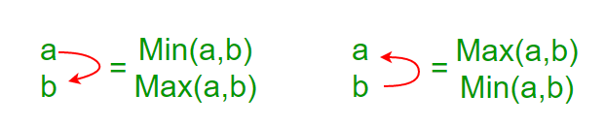
Example
Convert the following sequence to a bitonic sequence: 3, 7, 4, 8, 6, 2, 1, 5
Step 1: Consider each 2-consecutive element as a bitonic sequence.
And apply bitonic sort on each 2- pair element.
In the next step, take 4-element bitonic sequences and so on.

Slide 53
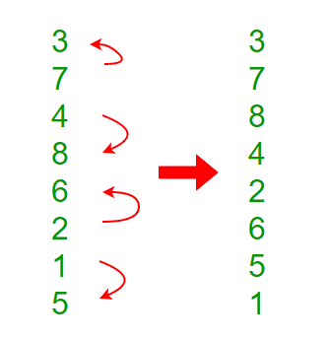
x0 and x1 are sorted in ascending order
x2 and x3 in descending order and so on

Slide 54
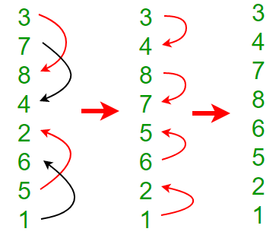
Step 2: Two 4 element bitonic sequences: A(3,7,8,4) and B(2,6,5,1) with comparator length as 2
After this step, we’ll get a Bitonic sequence of length 8.
3, 4, 7, 8, 6, 5, 2, 1

Slide 55
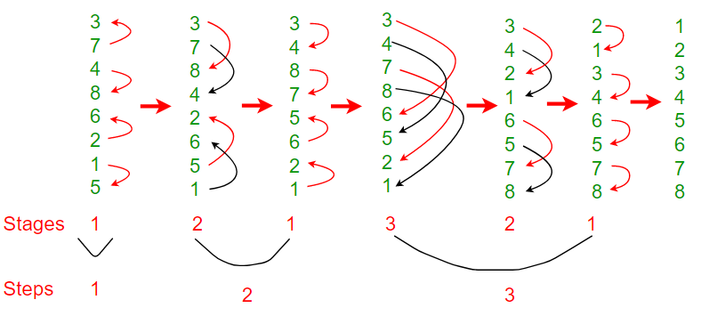

Slide 56
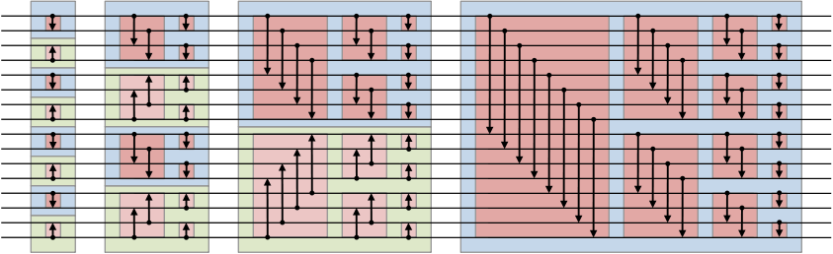
Bitonic sort network

Slide 57
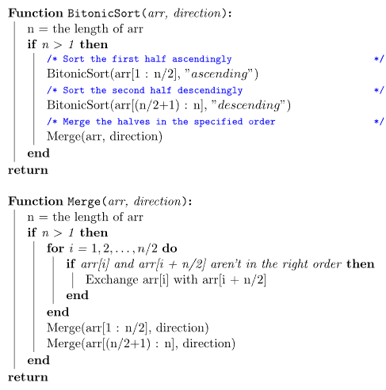
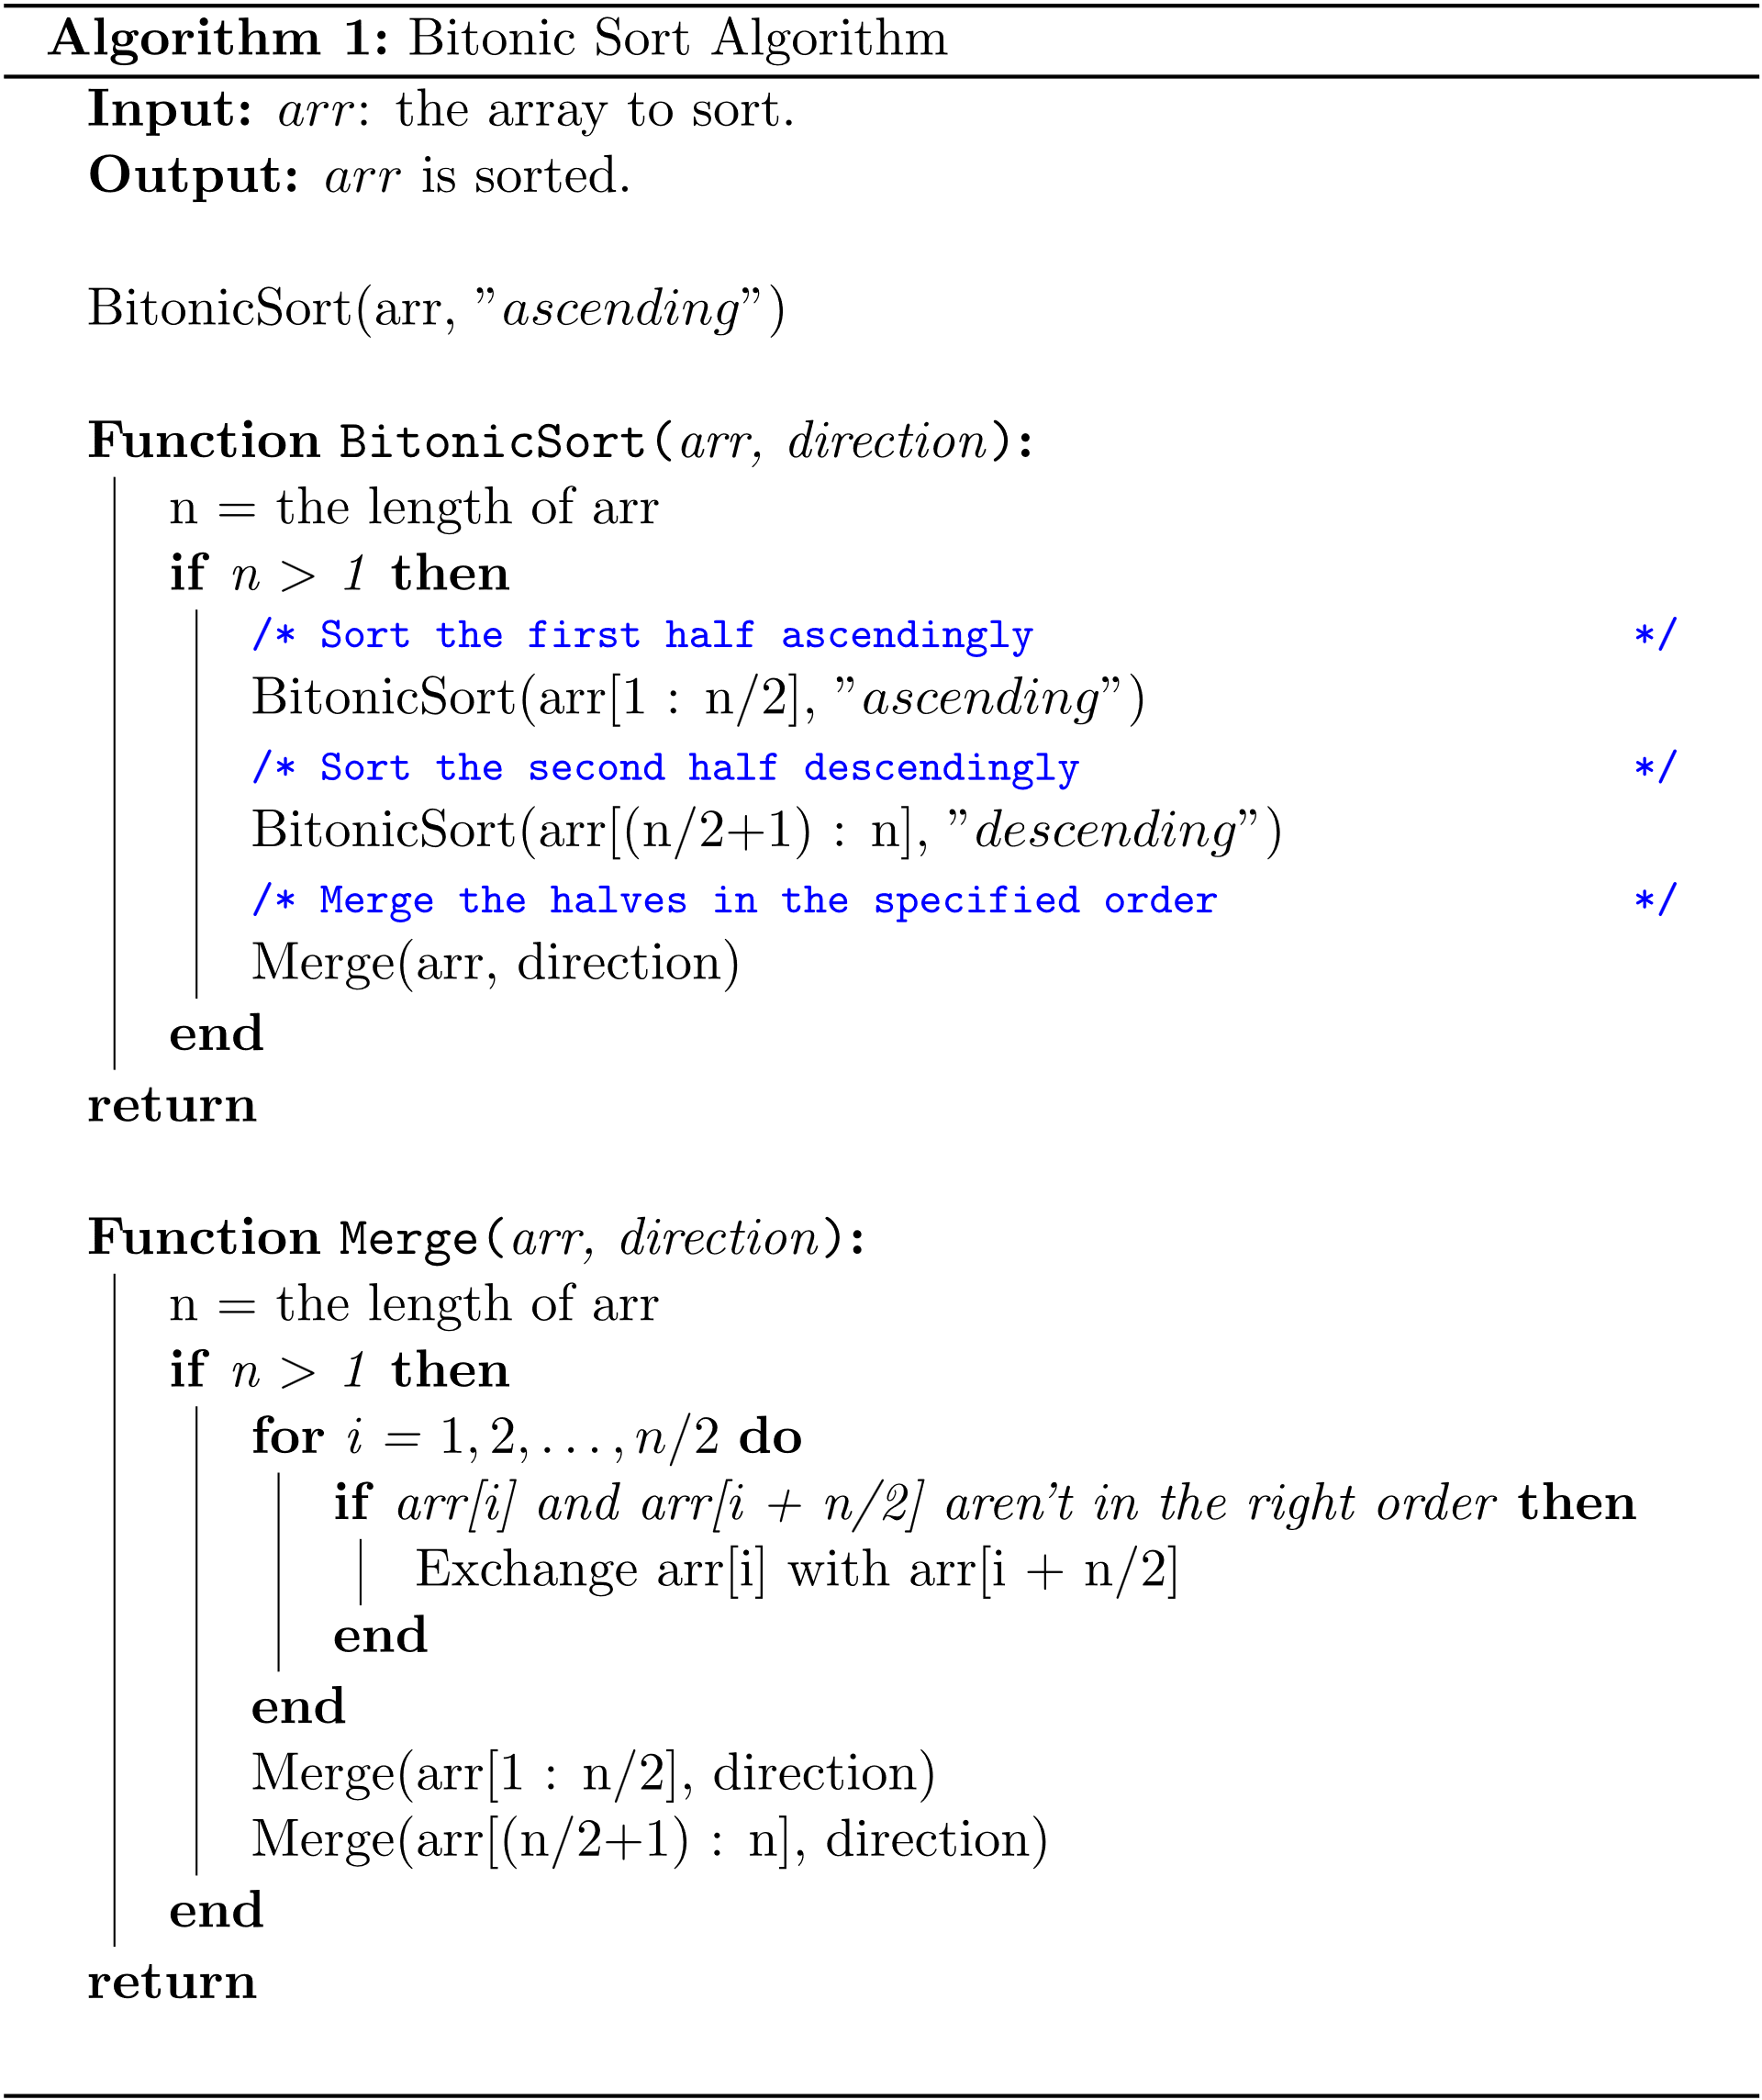
Algorithm

Slide 58
Complexity of MergeSort
Pass
Number
Number of merges
Merge list length
# of comps / moves per merge
1
2^{k-1} or n/2
1 or n/2^{k}
≤ 2¹
2
2^{k-2} or n/4
2 or n/2^{k-1}
≤ 2²
3
2^{k-3} or n/8
4 or n/2^{k-2}
≤ 2³
.
.
.
.
.
.
.
.
.
.
.
.
k = log n
k – 1
2¹ or n/2^{k-1}
2^{k-2} or n/4
≤ 2^{k-1}
k
2⁰ or n/2^{k}
2^{k-1} or n/2
≤ 2^{k}
58

Slide 59
Complexity of MergeSort
Multiplying the number of merges by the maximum number of comparisons per merge, we get:
(2^{k-1})2¹ = 2^{k}
(2^{k-2})2² = 2^{k}
•
•
•
(2¹)2^{k-1} = 2^{k}
(2⁰)2^{k} = 2^{k}
k passes each require 2^{k} comparisons (and moves). But k = lg n and hence, we get lg(n) • n comparisons or O(n lgn)
59

